Slide 1
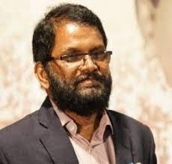
International Scout Volunteer Group
With
SOCIAL WORK
Dr. Jalindar Adsule
Principal,
Dr. Babasaheb Ambedkar College of Social Work affiliated to Kavayitri Bahinabai Chaudhari North Maharashtra University, Jalgaon, Maharashtra, India

Slide 2
Meaning of social work
Generally accepted meaning of social work
Social work is a profession primarily concerned with the remedy to psycho-social
problems and deficiencies which exists in the relationship between the individual and his social environment. This phenomenon always existed in the society in one form or the other, but achieved its scientific basis in the last decades of 19th century.
Speaking in a nutshell, social work intended to assist individuals, families, social groups and communities in sorting out their personal and social problems and permanently solving those problems through a systematic process.

Slide 3
Definition of social work
“That in all things.” “Social work as a professional activity of helping individuals, groups or communities enhance or restore their capacity for social functioning and creating societal conditions favorable to the goal.”
--- National Association of Social Workers, United States
“Social work as a field within human services and a part of services of the government. It considers social work as an important service to the society focusing on the individuals and families in need.”
-- United Nations Economic, Social and Cultural Organization, 2000

Slide 4
HISTORY OF SOCIAL WORK PROFESSION - WORLD
The root of social work education can be traced to their international beginning
In Britain and some countries in Europe toward the end of the 19th century
From Europe, the profession spread to United States, Africa, Asia and South America
1899- The Amsterdam Institute of Social Work Training is credited to be the first two-year training programme with theory and practice.
continues...

Slide 5
HISTORY OF SOCIAL WORK PROFESSION - WORLD
Women’s University Settlement established in 1889 in London by women graduates of Oxford and Cambridge. The training pioneered by this group evolved into organized course , and ultimately, into professional education for Social work.
1903 – The Alice Salomon School of Social Work, Germany
1904 – Mary Richmond – The New York School of Philanthropy
continues...

Slide 6
1920-Chicago School of Social Service Administration, the First autonomous graduate School of social work within a university.
1925-South America-Alejandro del Rio School of Social Work, offered a two-year programme.
continues...

Slide 7
1932-The first institution was a three-year diploma at the Cape Town and Transvaal University College. The first degree course was established at the University of Stellenbosch
1922-The first institution to be established In Asia was the Department of Sociology Yenching University
1936 - first school of Social Work in Asia goes to Tata Institute of Social Sciences, which became a university 1964.

Slide 8
HISTORY OF SOCIAL WORK EDUCATION IN INDIA
The first training course for social work as claimed by University Grants Commission (Social Work in Education in Indian Universities, 1965) was organized by Social Science League in Bombay in 1920. This was a short-term course meant for voluntary workers engaged in welfare work.
The first professional institution that provided training for a career in social work was established in 1936 in Bombay. The genesis of social work education in India has its roots in this establishment of Sir Dorabji Tata Graduate School of Social Work (later known as Tata Institute of Social Sciences).
After Independence, Kashi Vidyapeeth, Varanasi and College of Social Service, Gujarat Vidyapeeth, Ahmedabad were established in 1947,

Slide 9
In 1948, Delhi School of Social Work, (DSSW) came under auspices of North YWCA of India with assistance from Foreign Division of American YWCA. It is the pioneer institution offering two years post graduate course leading to Master's degree.
In 1949, University of Delhi granted affiliation and took up management of School in 1961. The first school as part of the University was established in Baroda in 1949-50 and Department of Social Work, Lucknow University was established in 1949.
Madras School of Social Work(1952) arid others were-established across the length and breadth Of the country

Slide 10
Social Work: The Indian Heritage
India has a long history of Social Work of which it can be justifiably proud.
The concept of concern for others, often in the form of charitable giving, has been enshrined in Hindu scriptures since ancient times
In addition to Indias sacred texts, there have been many historic individuals who have sought to provide help for the vulnerable and those in need.
Recent history has given us further examples of individuals who have furthered the cause of Social Work in India.
continues...

Slide 11
Raja Ram Mohan Roy sowed the seed of social and religious reform in his work for the abolition of Sati, in addition to supporting widow remarriage and women‟s education.
Iswar Chandra Vidya Sagar also advocated for widow remarriage and womens education, as well as economic self-reliance and an end to polygamy.
Gopal Hari Deshmukh promoted the establishment of dispensaries, maternity homes, and orphanages.
M.K. Gandhi worked tirelessly for the upliftment of women and dalits when, alongside his fight for freedom from foreign rule, he also
continues...

Slide 12
Christian missionaries spread education, brought the theory of equality, which in turn helped the social reforms to attack the evil customs and inequality.
Raya Ram Mohan Ray started the brahma samaj, Pandit Ramabhai started the Arya Samaj, Swami Vivekananda established Ramakrishna mission and Annie Besant started home rule movement against British.
Late Gandhi did a lot of work in the field of social reform
Due to the impact of the western education, and Christian missionaries, a new term of social work

Slide 13
Growth of Profession Training in India
Professional social work is of recent origin in India. During 1900 onwards, those who were engaged in social welfare activities found the need of trained social workers.
In India, professional social work owes its origin to a short- term training course on social service organized by the social service league at Bombay.
Later, the first school of social work was started in 1936 by Clifford marshal, who was a protestant missionary and worked in Nagpada. He came to Indian in 1925 and felt the need of trained social workers.
Later on different schools of social work came into existence in Delhi, Calcutta, herknow, Varanasi, baroda, agra, adaipur
continues...

Slide 14
Values in Social Work
1. Value: Service
Ethical Principle: Social workers' primary goal is to help
people in need and to address social problems.
2. Value: Social Justice
Ethical Principle: Social workers challenge social injustice.
3. Value: Dignity and Worth of the Person
Ethical Principle: Social Workers respect the inherent dignity and worth of the person.
4. Value: Importance of Human Relationships
Ethical Principle: Social workers recognize the central importance of
human relationships
Social Work's Core Values...continues

Slide 15
5. Value: Integrity
Ethical Principle: Social workers behave in a trustworthy manner.
6. Value: Competence
Ethical Principle: Social workers practice within their areas of competence and develop and
enhance their professional expertise.

Slide 16
Principles of Social Work
Acceptance
Respecting clients under different circumstances
Understanding the meaning and causes of clients behavior
Recognizing people’s strength and potentials, weakness and limitation.
2. Client’s participation in Problem Solving
Client is expected to participate in the process.
Participates in planning ways in resolving problem
Identifying resources to solve
Act through the available resources
3. Self-determination
Individual, groups and communities who are in need have the right to determine their needs and how they should be met.
Social Work's Principles...continues...

Slide 17
4. Individualization
Understanding client’s unique characteristics and different methods each client.
5. Confidentiality
Client should be accorded with appropriate projection, within the limits of the law, with no any harm that might result from the information given to the social worker.
6. Worker self-awareness
Social worker consciously examines her feelings, judgments, biases, responses whether it is professionally motivated.
7. Client Worker Relationship
The client is in need of help in social functioning and the worker is in the position to help.

Slide 18
SOCIAL WORK SUBJECT
Nature and Development of Social Work.
Society, Human Behavior and Communities.
Social Work with Individuals and Groups.
Social Work with Communities and Social Action.
continues...

Slide 19
Research in Social Work : Quantitative and Qualitative Approaches.
Administration, Welfare and Development Services.
Social Policy, Planning and Social Development.
Indian Constitution, Social Justice, Human Rights and Social Work Practice.

Slide 20
Eminent Social Worker in India and World “Famous” Leaders
Presidents, patriots, world leaders, inventors, explorers, educators, authors, religious leaders, activists
Baba Amte Mahatma Gandhi
Dalai Lama
Dr. B. R. Ambedkar Mother Teresa
Rev. Martin Luther King, Jr.
Walt Disney
Jyotiba Phule Raja Ram Mohan Roy
Rosa Parks

Slide 21
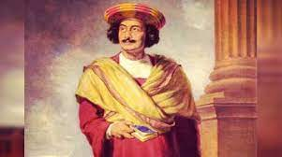
Raja Ram Mohan Roy
Raja Ram Mohan Roy was popularly known as the 'Father of Indian Renaissance ' was born on 22nd May 1772 in a Brahmin family in Bengal. He founded the Atmiya Sabha in 1815 and the Brahmo Samaj on 20th August 1828. Through these Institutions he fought against Orthodox Hindus and the fanatic Christian Missionaries.
He was against of Sati system, Polygamy, Child marriage, Caste system and Untouchability. He was the great supporter of Inter-caste marriage, women education, Widow remarriages etc. Ram Mohan started publishing Newspapers and Magazines for which he was called the 'Father of Indian Journalism'.

Slide 22
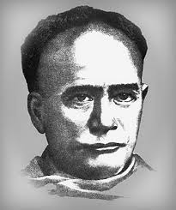
Ishwar Chandra Vidyasagar
He was born in 1820. He was a writer, a great philosopher, translator, educator and so more. Ishwar Chandra Vidyasagar was known by the pillars of the “Bengal Renaissance”. In Bengal, Vidyasagar brought a revolution in the education system.
He fought for the betterment of the status of the woman in India. He brought a revolution in the widow system and supported the widow remarriage. He closed his eyes in 1891.

Slide 23
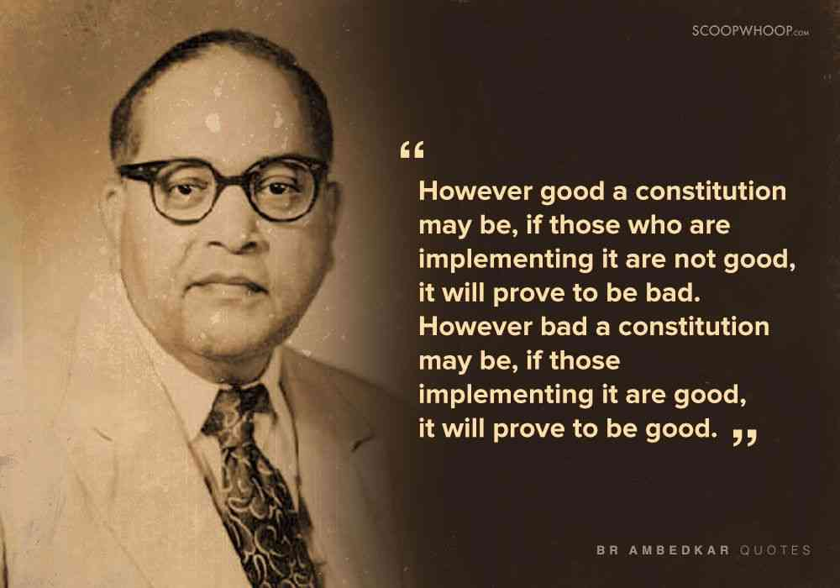

Slide 24
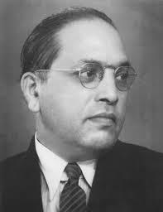
Dr. B. R. Ambedkar
Born-1981 Death-1956
Dr. Bhimrao RAMJI AMBEDKAR was an Indian social reformer who was an eminent political leader, Indian jurist, economist. He had a given precious contribution in the Indian constitution. We can say his pillar of the Indian constitution. He was belonging to a low caste family in the Hindu religion.
He fought for the reforms against social discrimination and the Hindu caste system. Dr. B. R. Ambedkar has been awarded the Bharat Ratna award which is the highest Indian civilian award for his outstanding performance in the social reformation in India.

Slide 25
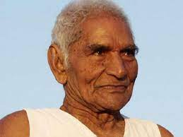
Baba Amte
One of the prominent social reformers of modern India was the Baba Amte. He was born in the Maharashtra, Wardha District on 26 December 1914. His important contribution to Indian society is his work for the care and rehabilitation of the people who suffer from leprosy.
His father was work for the British Government, he was the British Government officer. So his family was a wealthy family and he got a luxurious life from his childhood. But Baba Amte was a person who mingles in all castes and religions people. He tried spreading awareness about the leprosy disease.

Slide 26
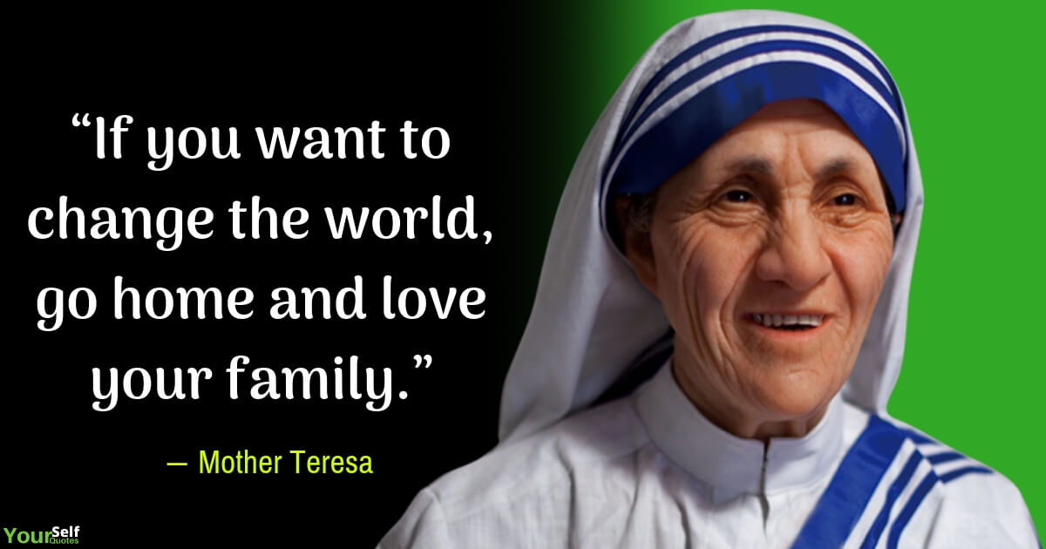

Slide 27
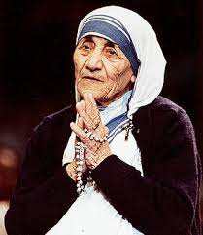
Mother Teresa
Birth – 1910 Death – 1997
The founder of Missionaries of Charity is a great lady and a great Roman Catholic nun, Saint Mother Teresa. The full name of mother Teresa is Agnes Gonxha Bojaxhiu. She was born on the 26th August in 1910 in Skopje, Macedonia.
The Nobel Peace Prize is awarded her for great works in 1979. She devoted her life to caring and serving poor people as well as the needy people. Her mission started in 1948 in India, Calcutta. “Missionaries of Charity”– where the group of sisters works dedicatedly who always ready to serve the poor people.

Slide 28
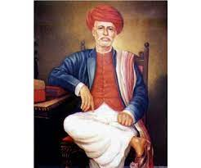
Jyotiba Phule
Birth-1827 Death-1890
The full name of Jyotiba Phule is Jyotirao Govindrao Phule. He was born on 11 April 1827 in Maharashtra, Satara district in a family of vegetable vendors. Due to the family’s poor condition, he could not able to complete his education but later he completed his education with the help of a few people who knew his potential.
At the age of 12, he married with the girl whose name is Savitribai Phule. He realized the caste discrimination and he began to fight against it. Thomas Paine, The Rights of Man writers motivated him to fight against the social evils such as caste system, untouchability, women’s pathetic condition. He was the first person who fights and supports the women’s education and his first disciple was his wife herself. He formed the Satyashodhak Samaj which is the Society of Truth Seekers. The objective of Satyashodhak Samaj was to create a just social order free of discrimination on the basis of caste. He closes his eyes on November 28, 1890.

Slide 29
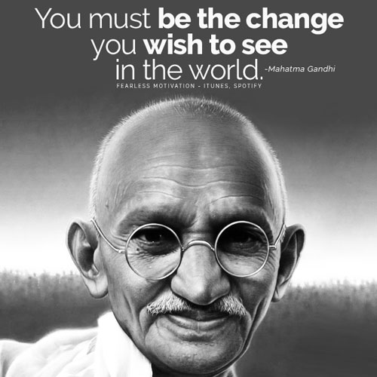

Slide 30
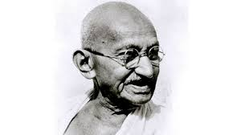
Mahatma Gandhi
Birth -1869 Death – 1948
The full name of Mahatma Gandhi is Mohandas Karamchand Gandhi. He had done a lot of struggles in the independence movement.
He was the pioneer of Satyagraha and he was a devotee of non-violence. Mahatma Gandhi was also called as the Father of The Nation. He fought against poverty, woman’s rights, etc.

Slide 32
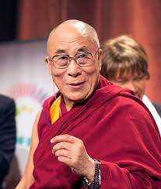
Dalai Lama
He is the fourteenth leader in a line of Buddhist spiritual and political leaders of Tibet. Born on 6 July 1935 to a farming family in northeastern Tibet.Age two: recognised as the incarnation of the 13th Dalai Lama.He began his monastic education at the age of six.
Leadership and exile
1950- His Holiness was called upon to assume full political power after China’s invasion of Tibet in 1949.
1954-He went to Beijing for peace talks with Mao Zedong, a Chinese Communist Leader.
1959- His Holiness was forced to escape in exile.Since then he has been living in Northern India ,the seat of the Tibetan political administration in exile.He has appealed to the United Nations on the question of Tibet. The General Assembly adopted three resolutions on Tibet in 1959,1961 and 1965.
“Free Tibet”
1963 : His Holiness presented a draft of democratic constitution for Tibet. May 1990: First time, the people of Tibet elected the political leadership.1992: As leader of Tibet, the Dalai Lama issued guidelines for a future free Tibet. 1989: Awarder the Noble Peace Prize for his non-violent struggle in the liberation of Tibet.

Slide 33
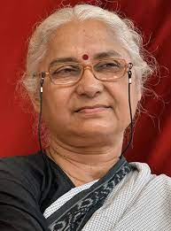
Medha Patkar
Medha Patkar was born in Mumbai. On 28 March 2006, Patkar started a hunger-strike to protest against the decision of the authorities to raise the height of the Narmada Dam. She ended her 20-day fast on 17 April 2006, after the Supreme Court of India refused the Narmada Bachao Andolan's appeal to stop the construction of the dam. She was held by the police at Singur on 2 December 2006 after protesting against the acquisition of farmland. She is a great social Reformer & social Activist.

Slide 34
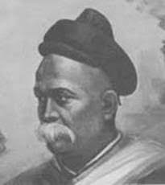
Justice Mahadev Govind Ranade
Justice Mahadev Govind Ranade was a distinguished judge, writer cum social reformer of India during the pre-independence era. Justice Mahadev Govind Ranade was a judge, politician, writer cum reformer of India. Politically, Ranade established the Poona Sarvajanik Sabha and was also among those who played a phenomenal role in setting up the Indian National Congress party. Justice Mahadev Govind Ranade was also an active reformer. He set up the Social Conference movement, which worked against infant marriages, widows remarriage, spending heavily in marriages and other social functions. Ranade advocated for widow remarriage and female education.

Slide 35
Social Work Intervention
Child Welfare Youth
Welfare Women Welfare
Welfare of the Aged and Infirm
Welfare Service for the Handicapped
Social defence Community
Welfare - Medical and Psychiatric Social Work
Industrial Social Work
Public Assistance
Social Insurance

Slide 36
SOCIAL WORK SPECIALTIES
Mental Health
Disaster Rellef
Foster Care
Crisis Intervention
Derontology
Child Abuse
Substance Abuse
Family Planning
Corrections
Private Practice
Social Work Research Planning & Policy
Occupational Social Work
Domestic Violence
Medical Social Work
Public Welfare

Slide 37
Impact of Social Work Profession
Social Workers with Achievements provide assessments, play therapy, and counseling for individuals, families, and groups. Our Social Workers help increase the child's opportunity for success in school by working with the child and family on issues such as understanding/coping with a disability, transition, grief/loss, social skills development, utilization of community resources, and parenting education.

Slide 38
References
http://wiki.answers.com/Q/When_did_social_work_begin_and _who_is_the_founder_of_social_work
http://web1.boisestate.edu/socwork/dhuff/history/central/core. htm
http://www.maduraimessenger.org/printed- version/2011/september/issues/
http://web.archive.org/web/20071221085300/http://www.socia lwork.ed.ac.uk/social/history.html
http://www.scribd.com/fullscreen/14826079?access_key=key- b722i6riz25zyzprdsv
https://www.iaspaper.net/social-reformers-essay/
https://www.achievements.org/social-work
https://www.sweducarebd.com/2017/08/fields-of-social-work-practice.html
http://www.ugcnetexam.co.in/ugc-net-social-work-syllabus.html

Slide 39
THANK YOU ANY QUESTION

